Slide 1
…and now for something really yummy!

Slide 2
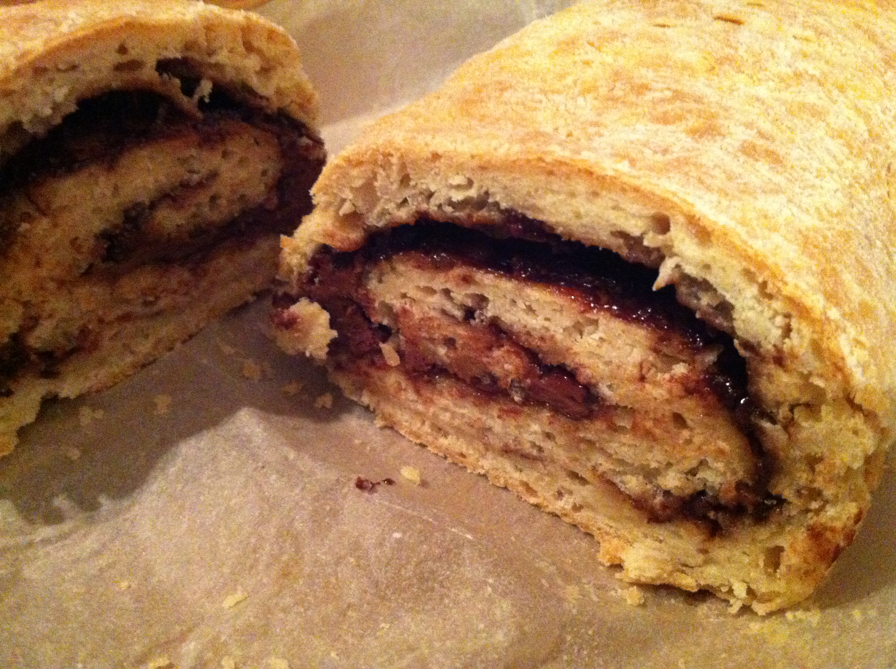
ROLY POLY

Slide 3
ROLY POLY
Chris Jaensch

Slide 4
Roly poly. roly poly round and round to the left, to the right, and high off the ground. Roly poly, roly poly down between your feet. Jesus is the best friend you’ll ever meet.

Slide 5
Roly poly to the left, roly poly to the right, roly poly down to the ground, roly poly way up high, way up high, to the sky.

Slide 6
Roly poly’s that dessert that my mother used to make. It’s kinda like a pie and nicer than a cake. With jam in the middle and pastry outside it tastes so good it makes me wanna sigh….mmm that’s good!

Slide 7
Roly poly, roly poly with a friend up and down, around the bend, back to back and side to side. Spin around in circles and take ‘em for a ride.

Slide 8
Roly poly back to back, roly poly side to side, roly poly head to head, roly poly way up high, way up high. High, low, high, low, high, low, high!!

Slide 9
Roly poly’s nice but it gets kinda sticky like life when it’s good but gets kinda tricky. You’re stuck in a jam. You don’t know what to do but Jesus is there. He’ll help you through.

Slide 10
Roly poly now with some clever moves. Make up your own, that’s what you can do. Get your hands rolling round and round. Get ‘em spinning and twisting to the moves you’ve found.

Slide 11
Roly poly to the left, roly poly to the right, roly poly to the ground, roly poly way up high, way up high, to the sky.

Slide 12
Roly poly. roly poly round and round to the left, to the right, and high off the ground. Roly poly, roly poly down between your feet. Jesus is the best friend you’ll ever meet.

Slide 13
Jesus is the best friend you’ll ever meet. Jesus is the best friend you’ll ever meet.

